Slide 1
Natural Language Processing
Unit 14 Sentiment Analysis
Faizan Javed
DataScience @ SMU

Slide 2
Admin notes
HW8 due 1hr before live session 15
Final Exam – Live Session 15 (no meeting), and final glossary

Slide 3
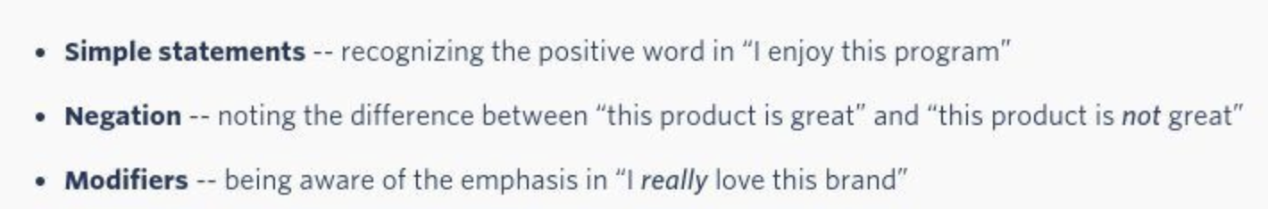
Sentiment Analysis (SA)
Also known as opinion mining, opinion analysis,
Unstructured textual data has facts (objective) and opinions (subjective)
Computational study of opinions, sentiments and emotions expressed in text.
Extract subjective and opinion such as emotions, attitude, mood, modality, et al to compute the polarity of a document
Polarity: positive, negative, or a neutral sentiment.
Advanced analysis: complex emotions such as sadness, happiness, anger, and sarcasm.

Slide 4
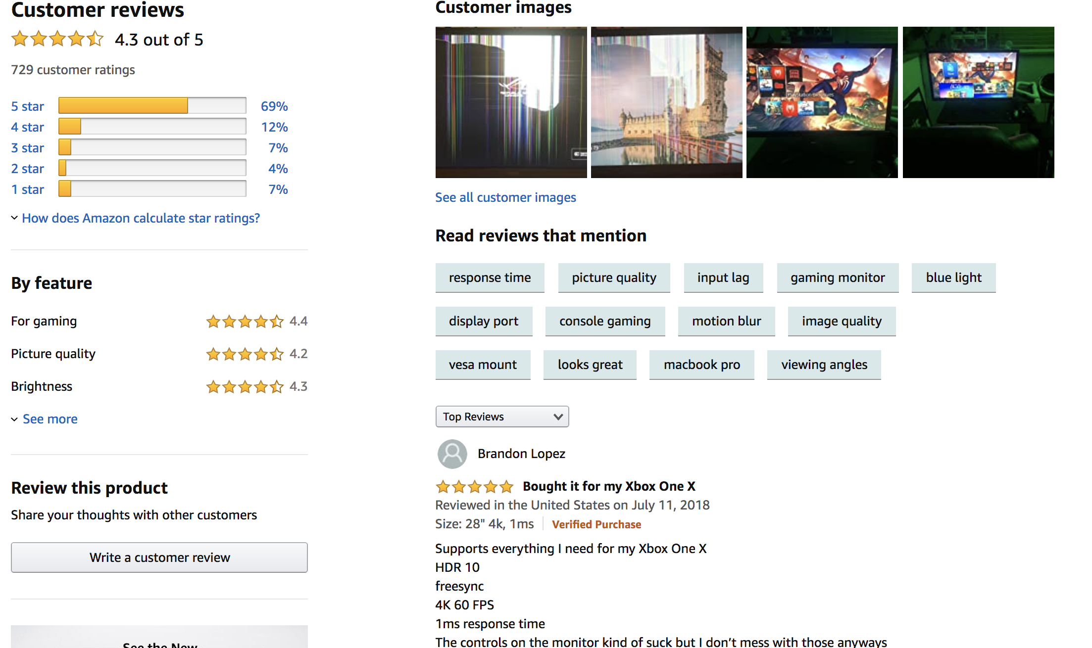
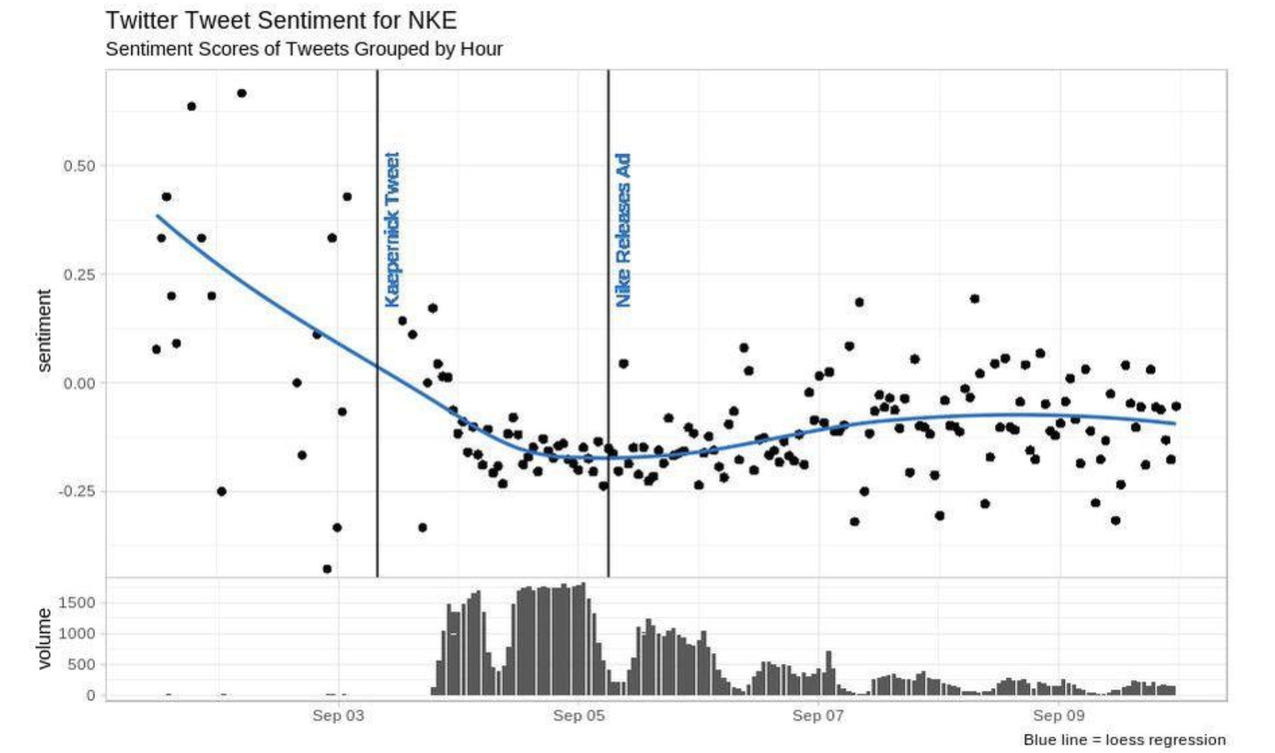
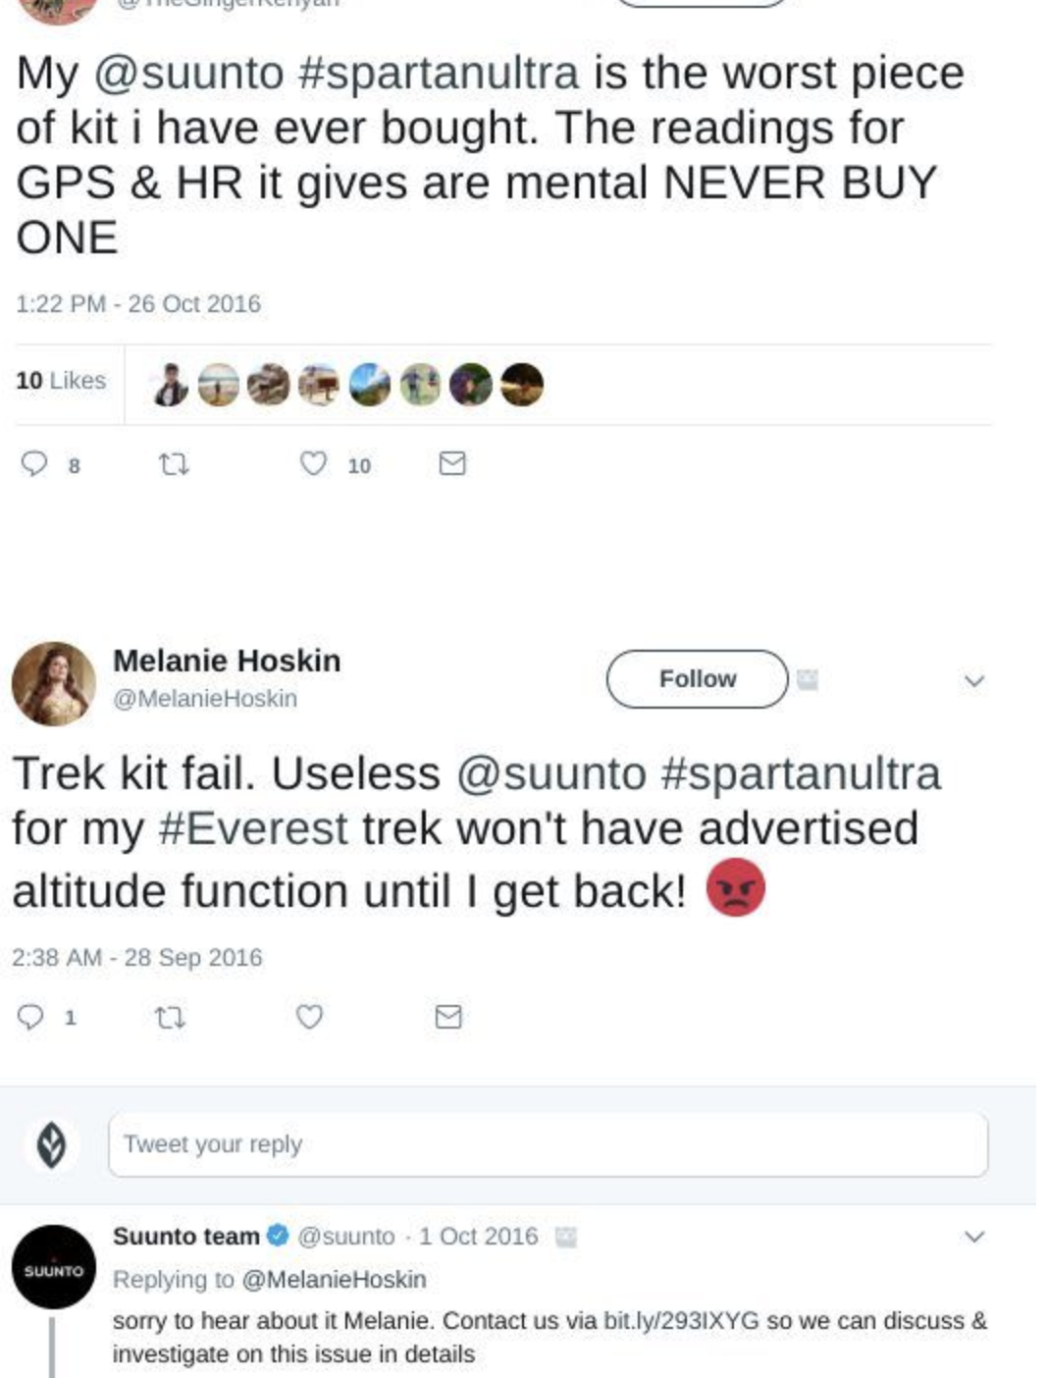
Use cases
Uncover what customers are saying but why they are saying it
Brand monitoring/customer sentiment: e.g., nike, sentiment decreased but sales increased
Improve customer service: tickets, feedback (25% of customers drop a service/brand after one bad experience!)
Track change in product or services(via User Generated Content): tweets, facebook posts, revie ws

Slide 5
Example: iPhone Product Review Courtesy B.liu
“I bought an iPhone a few days ago. It was such a nice phone. The touch screen was really cool. The voice quality was clear too. Although the battery life was not long, that is ok for me. However, my mother was mad with me as I did not tell her before I bought the phone. She also thought the phone was too expensive, and wanted me to return it to the shop. …”
Opinions, opinion targets, and opinion holders, ...

Slide 6
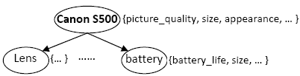
What is an opinion?
An opinion is a quintuple
(o_{j}, f_{jk}, so_{ijkl}, h_{i}, t_{l}),
where
o_{j} is a target object.
f_{jk} is a feature of the object o_{j}.
so_{ijkl} is the sentiment value of the opinion of the opinion holder h_{i} on feature f_{jk} of object o_{j} at time t_{l}. so_{ijkl} is +ve, -ve, or neu, or a more granular rating.
h_{i} is an opinion holder.
t_{l} is the time when the opinion is expressed.

Slide 7
SA requires multiple NLP techniques!
(o_{j}, f_{jk}, so_{ijkl}, h_{i}, t_{l}),
o_{j} - a target object: Named Entity Extraction (more)
f_{jk} - a feature of o_{j}: Information Extraction
so_{ijkl} is sentiment: Sentiment determination
h_{i} is an opinion holder: Information/Data Extraction
t_{l} is the time: Data Extraction
Co-reference resolution
Relation extraction
Synonym match (voice = sound quality) …
None of them is a solved problem!

Slide 8
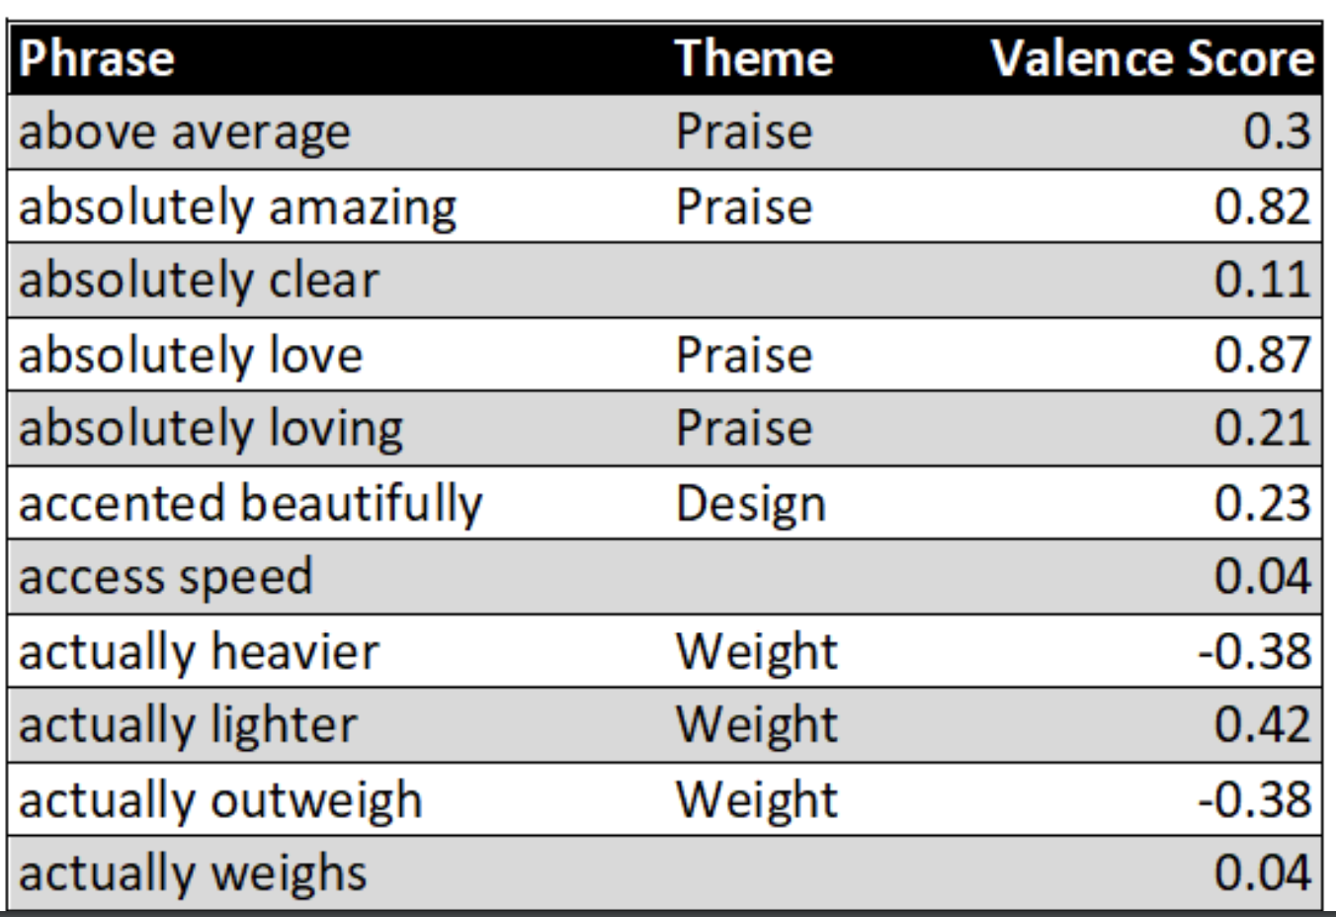
Techniques for Sentiment Analysis
Supervised learning:
Training data (sentiments as classes), classifiers,
document or sentence-level classification
Lexicon-based approaches:
Dictionaries or vocabularies of words annotated by polarity score.
Does not require any training data but may lack coverage.

Slide 9
Sentiment Classification: document-level
Classify a document (e.g., a review) based on the overall sentiment expressed by the opinion holder
Classes: Positive, or negative
Assumption: each document has a single object and contains opinions from a single opinion holder.
E.g., is this review positive or negative?
“I bought an iPhone a few days ago. It was such a nice phone. The touch screen was really cool. The voice quality was clear too. Although the battery life was not long, that is ok for me. However, my mother was mad with me as I did not tell her before I bought the phone. She also thought the phone was too expensive and wanted me to return it to the shop. …”

Slide 10
Subjectivity Analysis: sentence-level
Sentence-level sentiment analysis has two tasks:
Subjectivity classification: Subjective or objective.
Objective: e.g., I bought an iPhone a few days ago.
Subjective: e.g., It is such a nice restaurant.
Sentiment classification: For subjective sentences or clauses, classify them positive or negative.
Positive: It is such a nice restaurant.
But subjective sentences don’t imply +ve or –ve opinions
E.g., I think he arrived yesterday.
Similarly, objective sentence doesn’t imply no opinion
Implies negative: The phone broke in two days

Slide 11
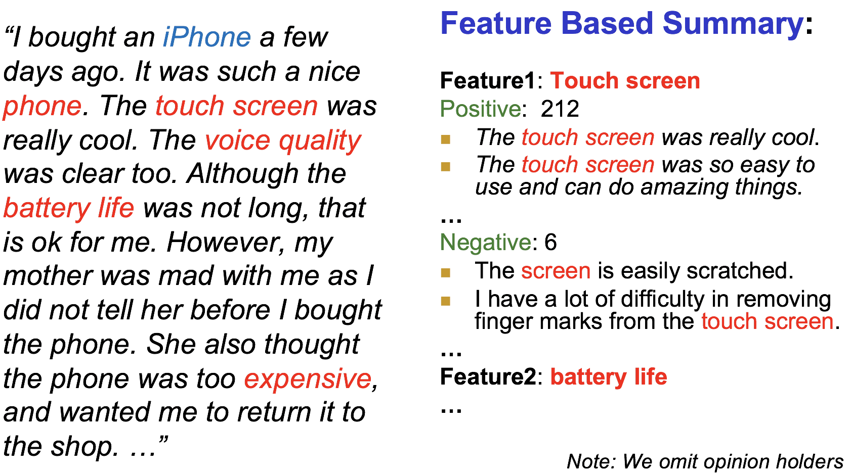
Feature-Based Sentiment Analysis
Sentiment classification at both document and sentence (or clause) levels have limitations:
They do not give a complete picture of what people like and/or dislike
A +ve/-ve opinion of an object does not mean that the opinion holder likes everything about the object

Slide 12
IMDB movie reviews example
50,000 movie reviews from the Stanford AI dataset.
Rating scale: 1-10
Positive review: 6 stars or higher
Negative review: less than 5 stars
P/N reviews may contain aspects of both negative and positive contexts

Slide 13
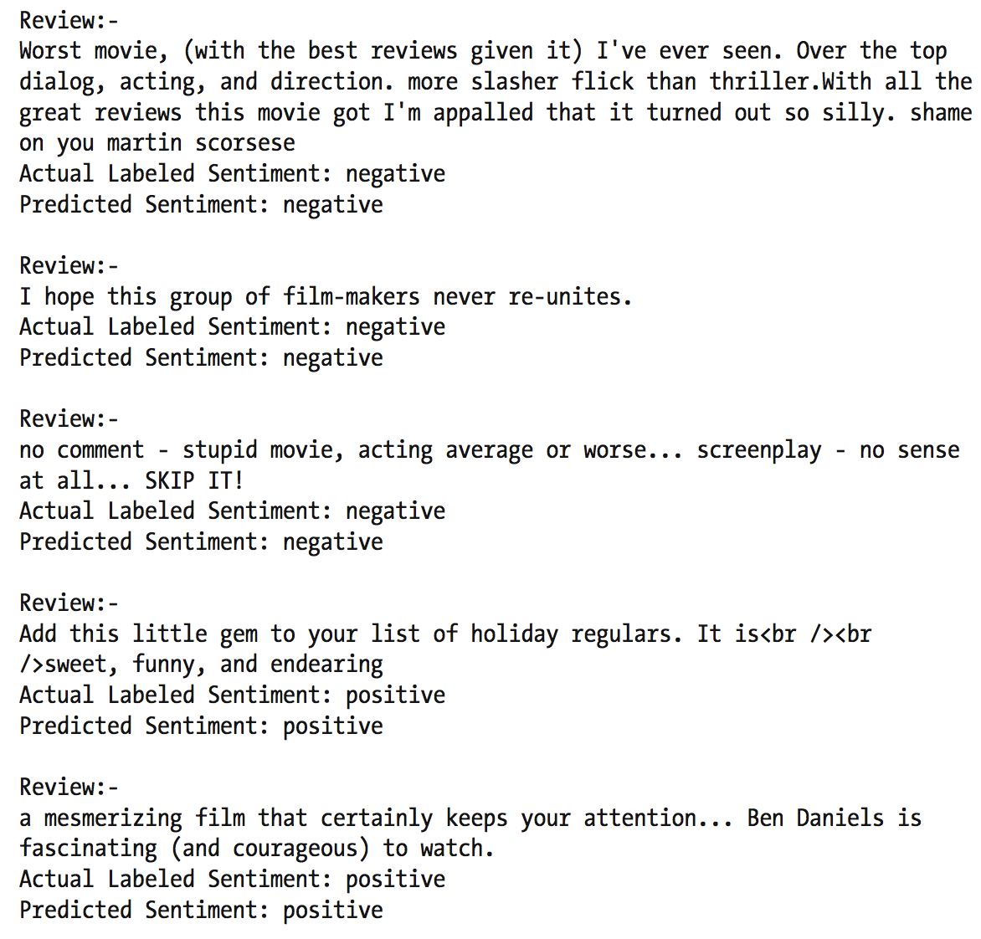
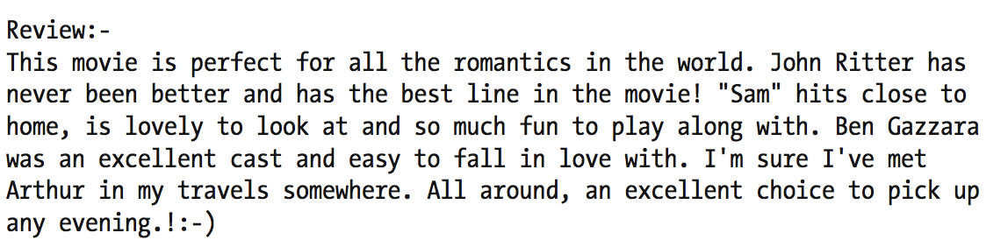
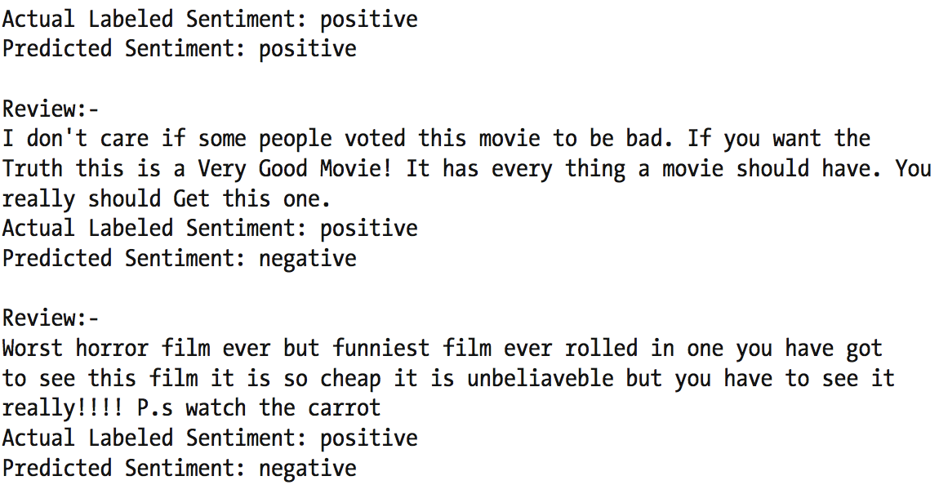
Supervised Machine Learning
Pre-process/Normalize training data, extract features, Use SVM classifier

Slide 14
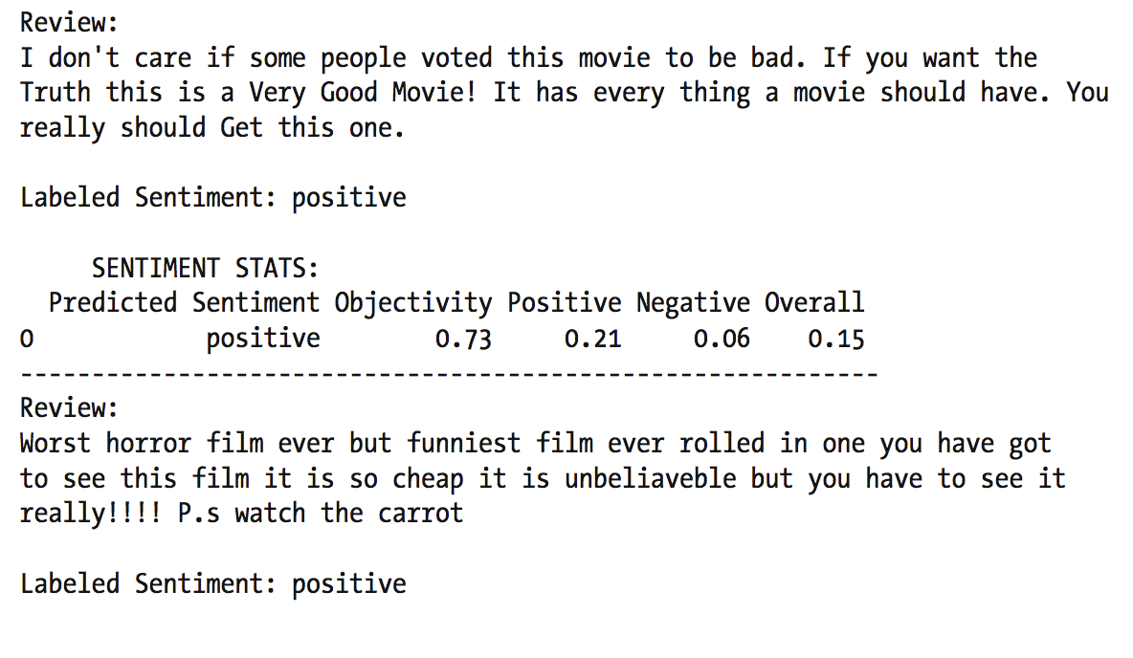
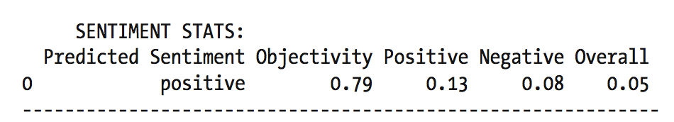
SentiWordNet lexicon
Each synset is assigned a positive polarity, negative polarity and objectivity scores.
Pre-process, tokenize and POS tag the tokens.
For each pair of (word, tag) check whether any senti-synsets exist for the same word and its corresponding tag.
If there is a match, take the first senti-synset and its sentiment scores
Aggregate all scores.

Slide 15
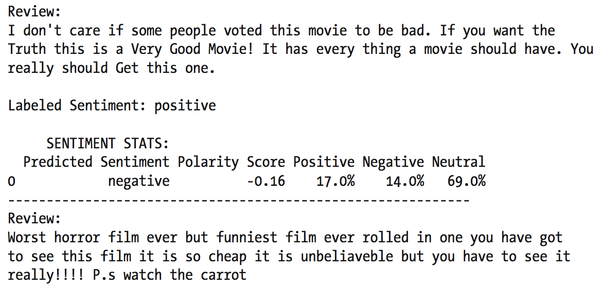
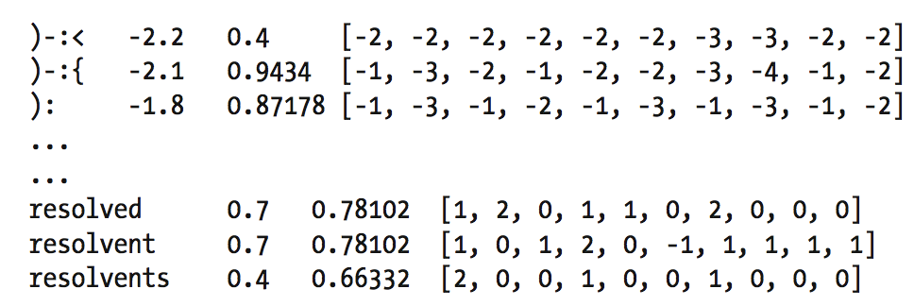
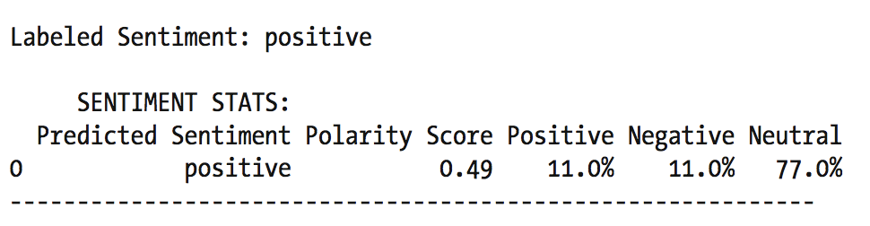
Vader lexicon – Valence Aware Dictionary and sEntiment Reasoner
Rule-based framework built for analyzing social media resources.
Scores for words, emoticons, slang (lol, wtf, nah, etc.)
Scale: [-4] Extremely negative, [0] Neutral. [4] Extremely positive.

Slide 16
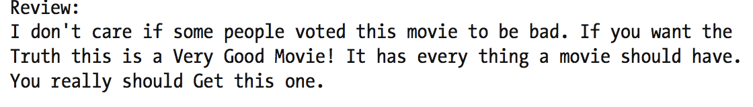
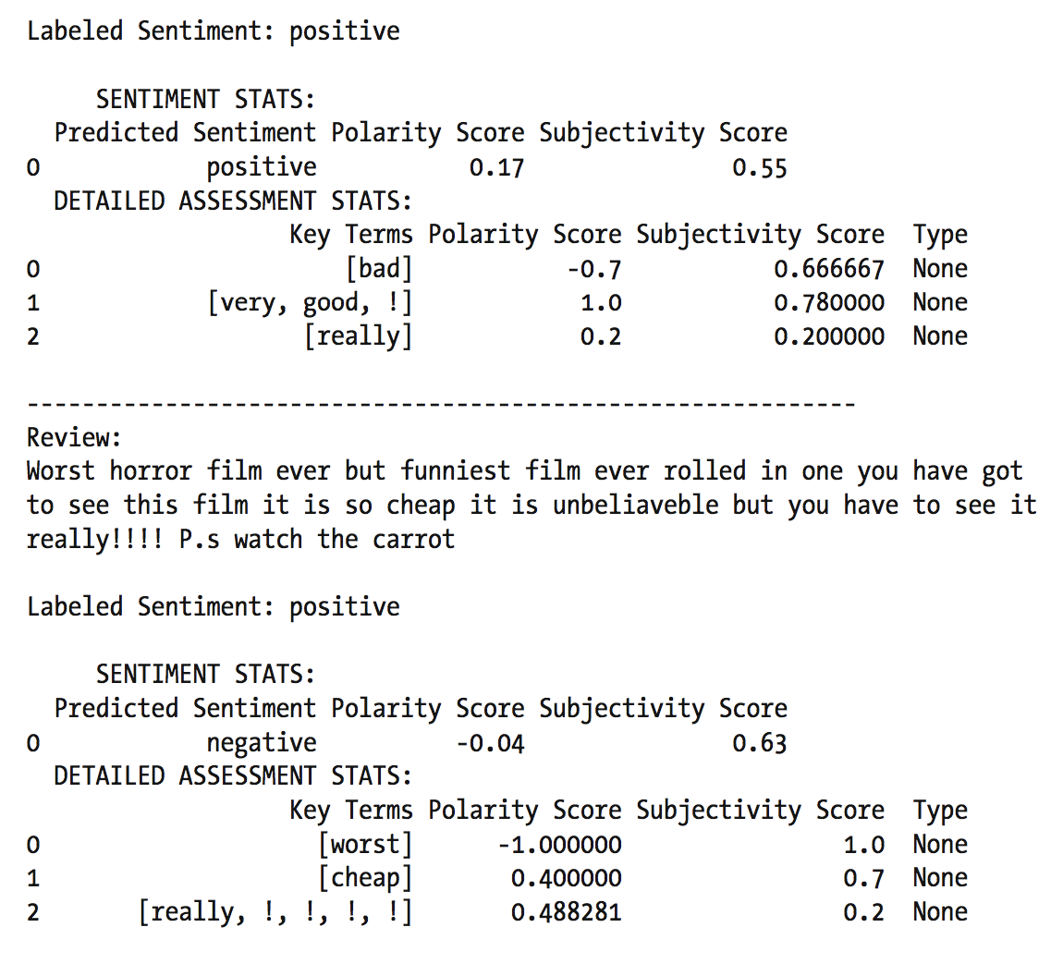
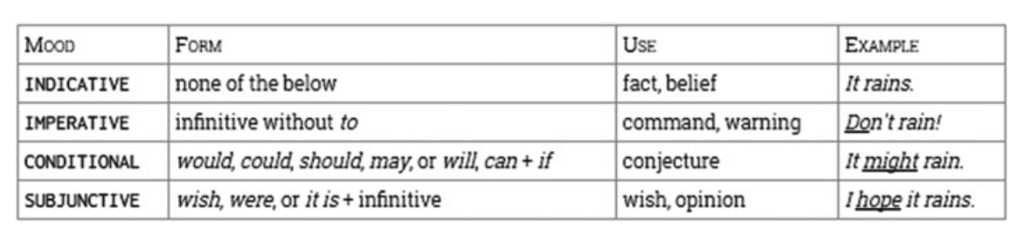
Pattern lexicon
Package from the CLiPS lab at Univ of Antwerp
Decomposes text into sentences, tokenizes and adds POS.
Subjectivity-based lexicon contains scores such as polarity, subjectivity, intensity, confidence et al
Also supports mood

Slide 17
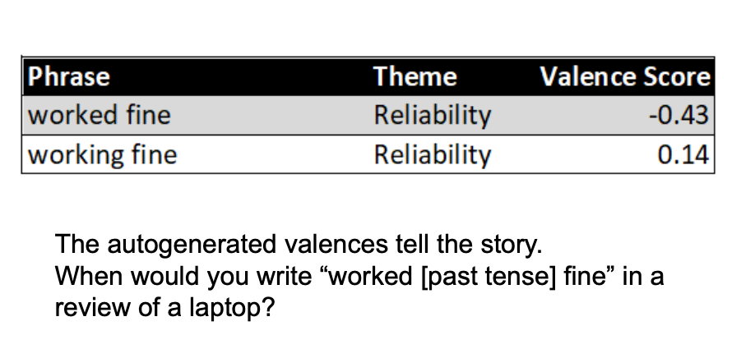
Stemming/Lemmatization is not always a good idea!

Slide 18
Analysis of problems
Reviews:
comparatively easier to tackle; less noisy and objects/entities are usually provided.
Forum discussions and blogs:
comparatively harder to tackle:
Objects are not given, and a large amount of noise
Determining sentiments seems to be easier.
Determining objects and their corresponding features is harder.
Combining them is even harder.

Slide 19
What did you learn today?
Questions?

